Slide 1
Chair’s Report
William Paterson University of New Jersey
Faculty Senate
Tuesday, September 24, 2019

Slide 2
From SEPP Meetings
Academic Partnerships
ART
50K gift to Senate
University Budget
Consolidation

Slide 3
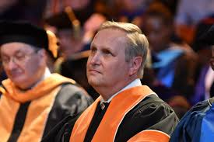
“Today’s college graduates may change their careers—not their jobs, their careers—seven times before they are 40…I often tell students that their major will help them get their first job, but it is the first two years of their degree—at William Paterson our core curriculum and its focus on writing and critical thinking—that will help them make the jump to their next career” (President Helldobler, WP Magazine Fall 2018)

Slide 4
Senate Exec Rationale for Criteria & Models
Innovation
Preserve Academic Integrity
Preserve Jobs

Slide 5
Consolidation – Criteria & Metrics
5 or fewer full time faculty members
Fewer than 50 majors
Fewer than 10 graduates per year
President’s Recommendation
4. Number of minors
5. UCC Student Credit Hours
6. Financial contribution
7. Any two others?
Senate Recommendation

Slide 6
Possible Paths
Preserve → stay as-is ~ Not recommended
Scatter → Individual faculty seek new dept home ~ Not recommended
Add & Stir → ‘consolidation without merger’ ~ Low viability
Subsume → dept as unit joins larger dept. ~ Context dependent
Create / Innovate → create new dept, major, interdisciplinary spaces

